Slide 1



Great Datasets: A Story
Alex Cookson
@alexcookson
tacookson
_

Slide 2
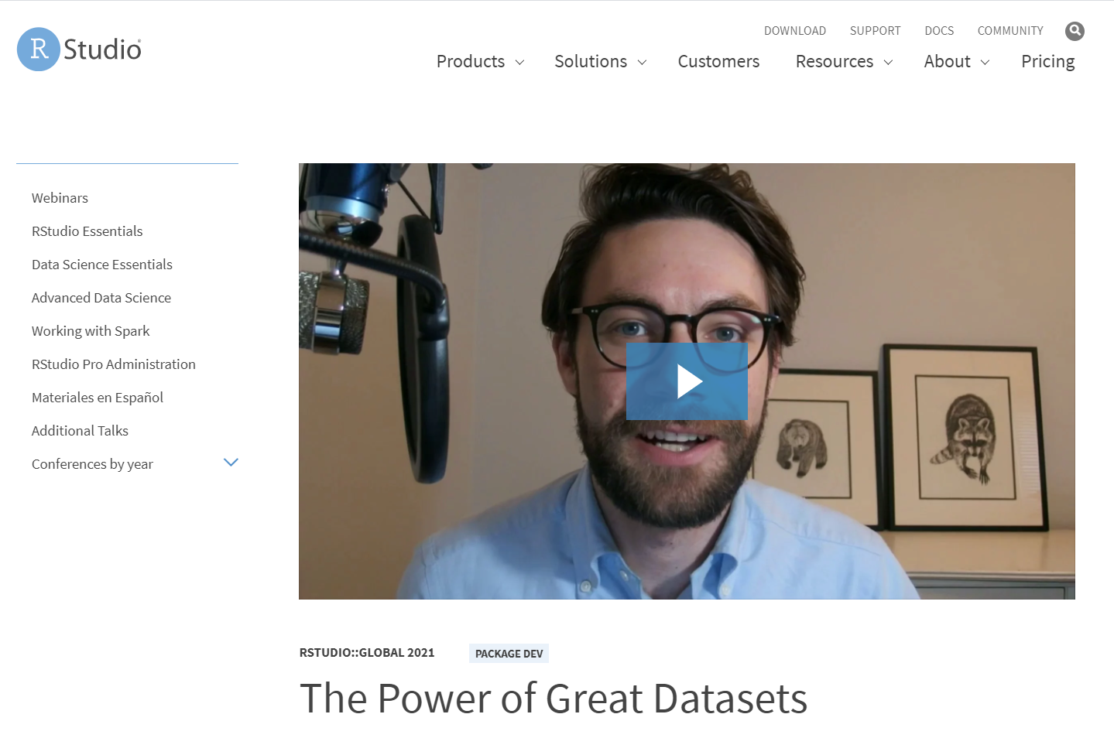
Bored?
Watch the 5-minute version of this talk

Slide 3
Set up the structure
Boy meets boy
Boy meets girl
Non-gendered person meets girl
Etc.
Learner meets Data

Slide 4
Rom-com
The Meeting
Sparks Fly
Tension/Crisis
Falling in Love

Slide 5
The Meeting
Seeing Hamilton
Brother (big Broadway fan) told me about weekly grosses, published by the Broadway league
[Description of data]
Curiosity piqued

Slide 6
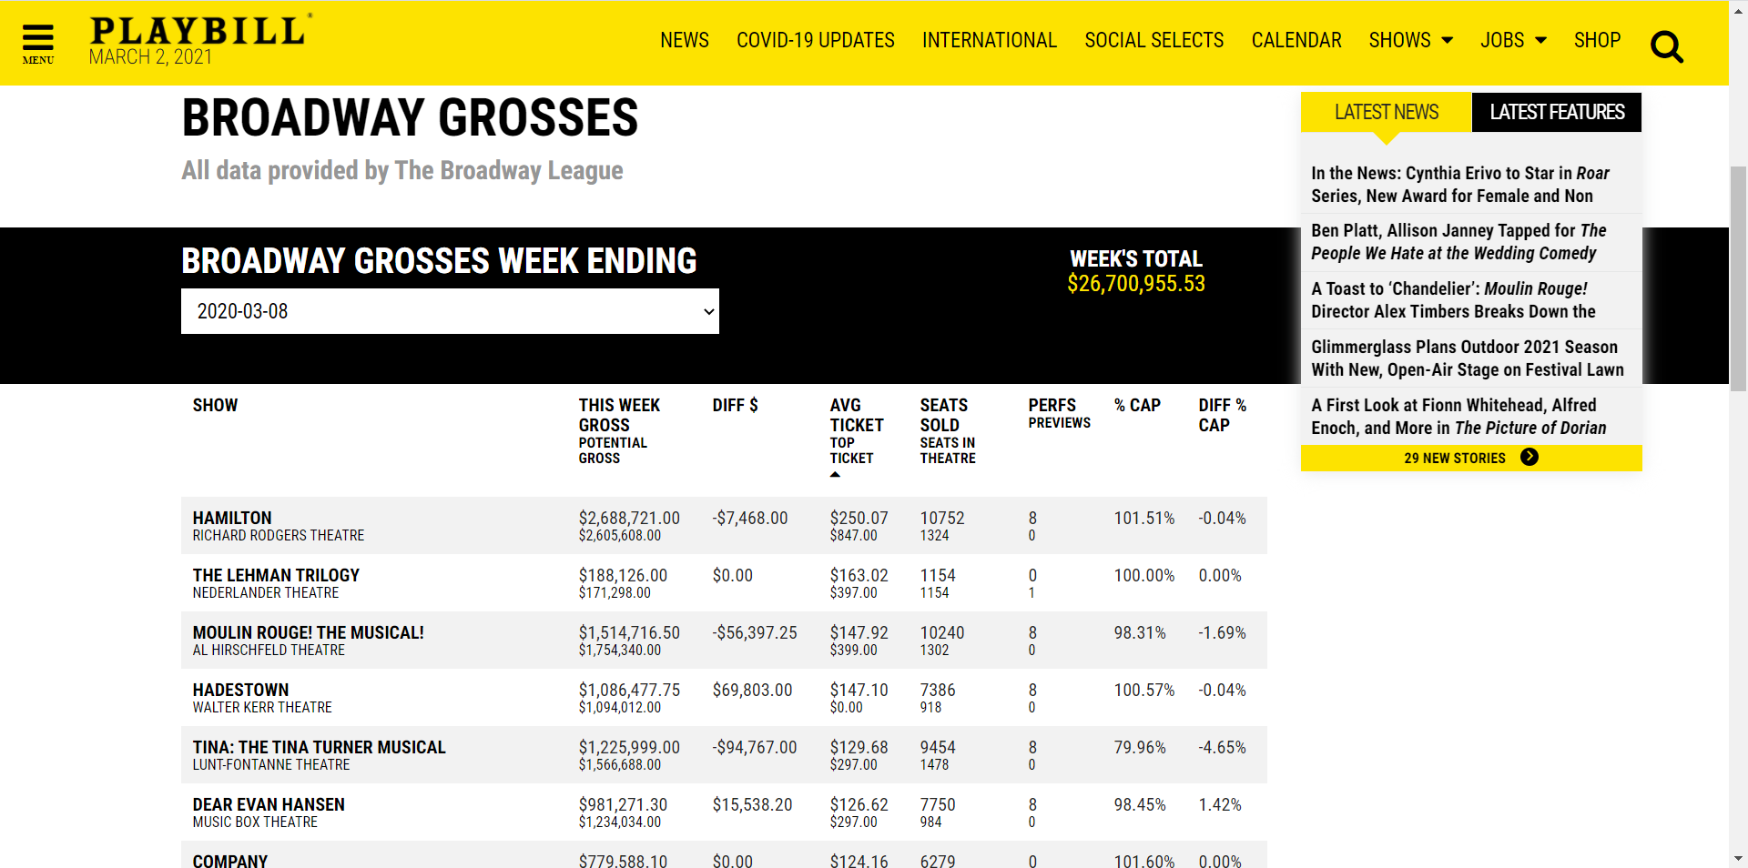
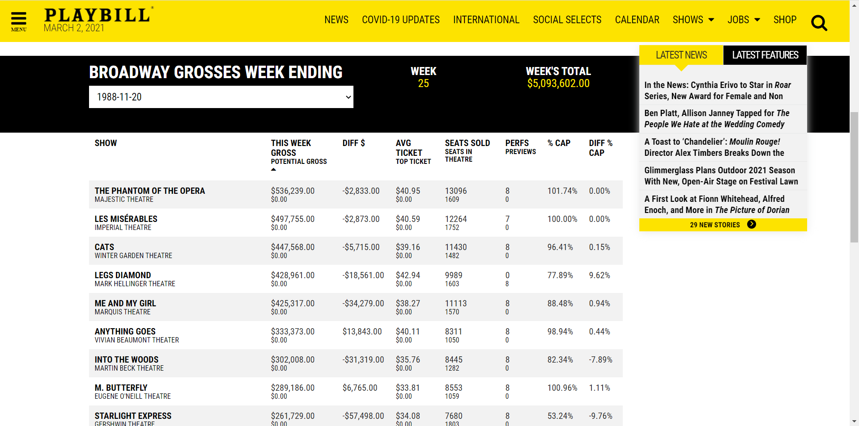
Sparks Fly
Cool data confirmed!
Ask questions like, “How expensive are Hamilton tickets really?
What was popular the week I was born? (data goes back to 1985)

Slide 7
Tension/Crisis
Thought: exploring the data week-by-week is okay
I don’t want data (one week at a time) – I want DATA (full dataset)
Problem: I knew exactly where the data was, but I couldn’t get to it
Solution: learn how to web-scrape (rvest, html tags)

Slide 8
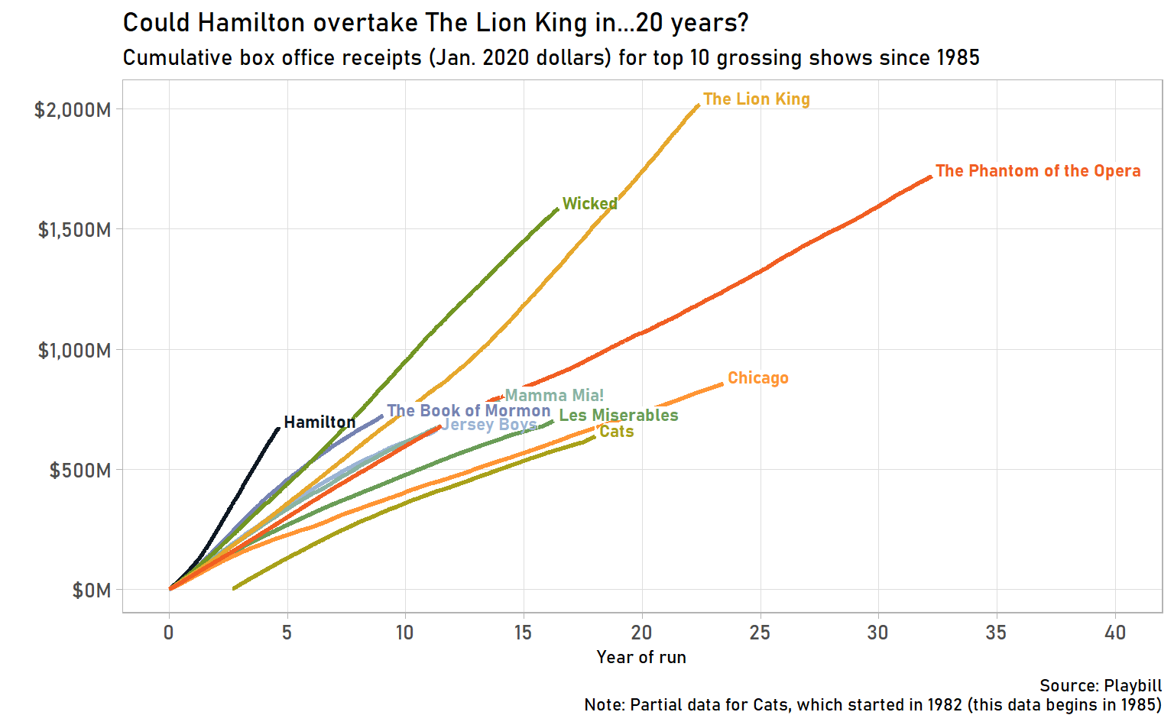
Falling In Love
Scraped data
Wrote a blog post
Submitted dataset to #TidyTuesday
David Robinson saying “This is so cool!” about this dataset

Slide 9
Love Story kept repeating itself
Japanese mascots (use Google Language API)
Sakura flowering (gganimate)
Fictional character personalities (Principal Component Analysis)
U.S. diplomatic gifts (parsing PDFs, natural language processing)

Slide 10
Great Datasets: A Story
Alex Cookson
@alexcookson
tacookson
_

Slide 11
Great Datasets: A Story
—
—
^
ies
—
^
Many
Alex Cookson
@alexcookson
tacookson
_

Slide 15
How do I learn how to do [thing] in R?

Slide 16
How do I learn how to do [thing] in R?
[ sentiment analysis ]
[ data visualization ]
[ web scraping ]
[ forecasting ]
[ … ]

Slide 17
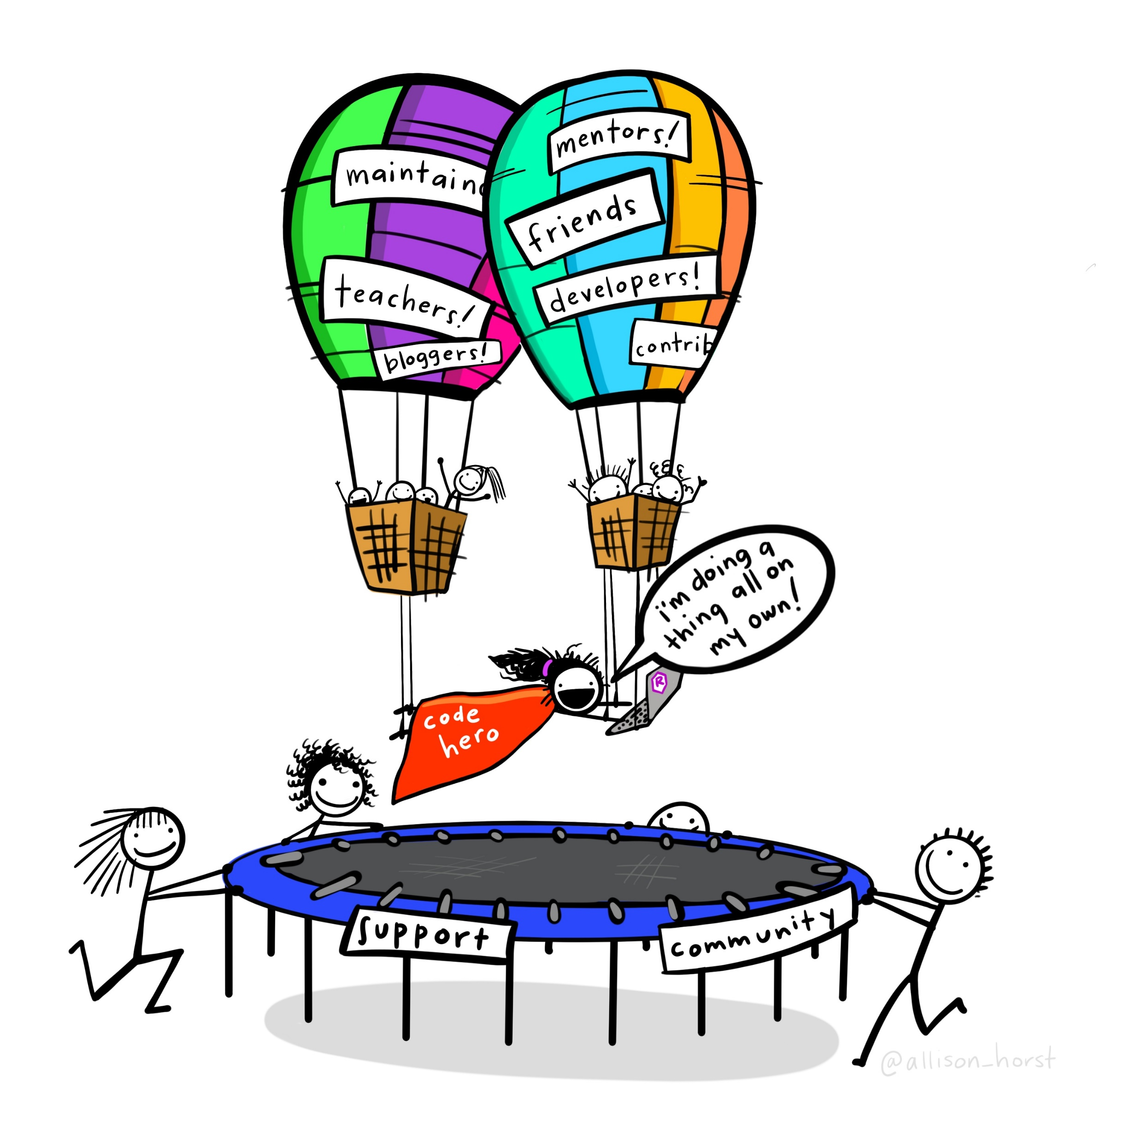
Artwork by @allison_horst

Slide 18
What about
Great Datasets are
?

Slide 19
Great Datasets are COOL

Slide 20
Great Datasets are COOL
and
INTERESTING

Slide 21
Great Datasets are COOL
and
INTERESTING

Slide 22
Great Datasets are COOL
and
INTERESTING
“That’s cool!”
Cool to me isn’t (necessarily) cool to you
Speaks to you on a deeper level

Slide 23
Great Datasets are COOL
and
INTERESTING

Slide 24
Great Datasets are COOL
and
INTERESTING
Prompts you to ask questions
Rouses your curiosity
“Just one more graph”

Slide 25
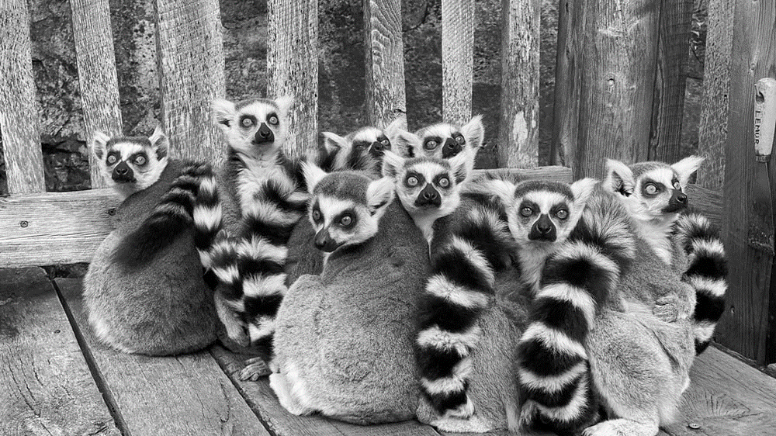
Duke Lemur Center
Ring-tailed Lemurs have an average weight of 2.2kg

Slide 26
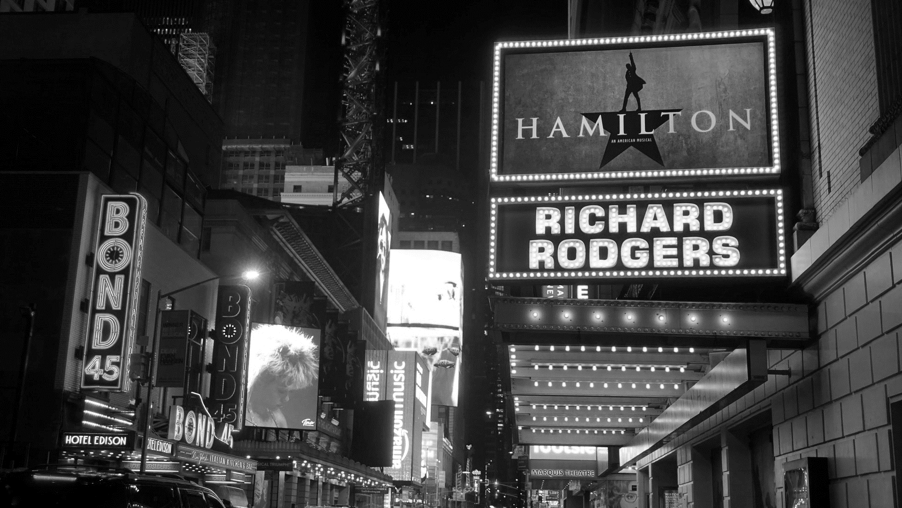
Broadway Grosses
Hamilton holds the record for top ticket price on Broadway — $998

Slide 27
Fictional Character Personalities

Slide 28
Fictional Character Personalities

Slide 29
Fictional Character Personalities
Traits of 800 characters across 250+ spectrums

Slide 30
Fictional Character Personalities
Traits of 800 characters across 250+ spectrums
Playful
Serious

Slide 31

Fictional Character Personalities
Traits of 800 characters across 250+ spectrums
Michael Scott
(The Office)
Playful
Serious

Slide 32
Fictional Character Personalities
Traits of 800 characters across 250+ spectrums
Worf
(Star Trek: The Next Generation)
Michael Scott
(The Office)
Playful
Serious

Slide 33
What are some of my favourite characters’ personalities?

Slide 34
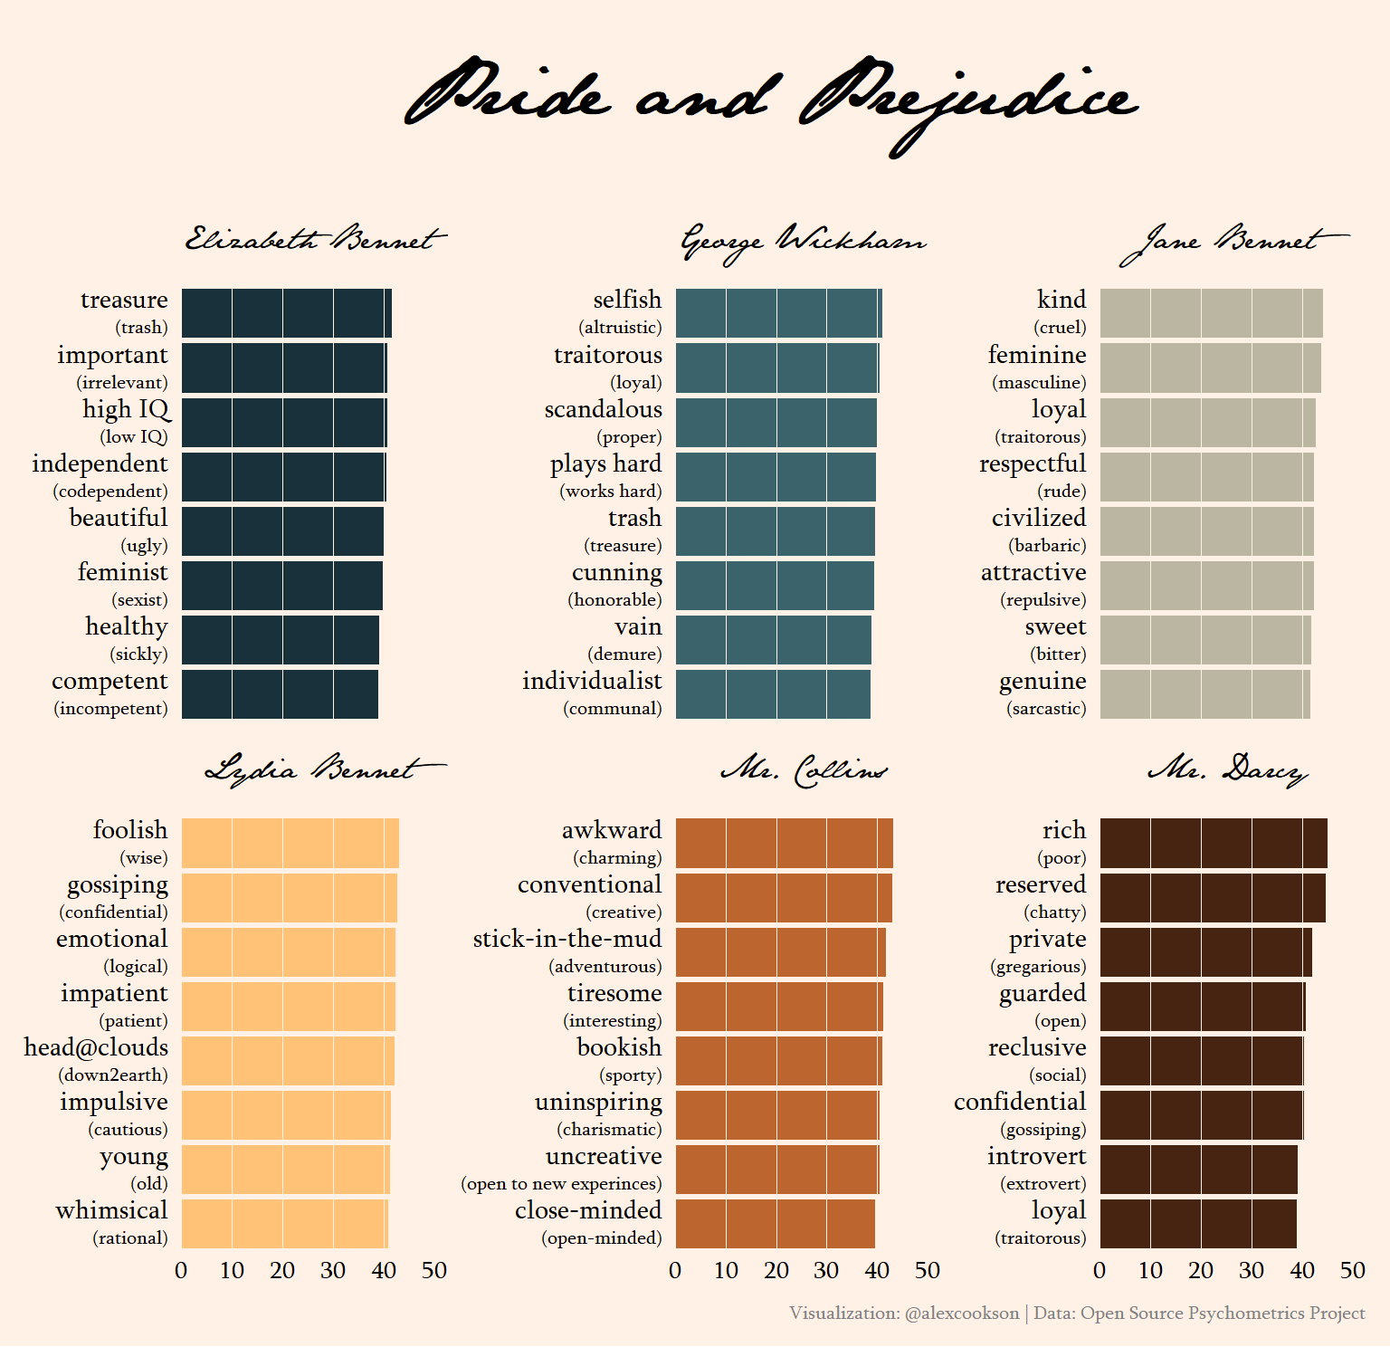

Slide 35
Use custom fonts
Tweak labels with {glue} and {ggtext}
Choose an appropriate colour palette
Adjust a LOT of theme() elements

Slide 36
Which characters are most similar to one another?

Slide 37
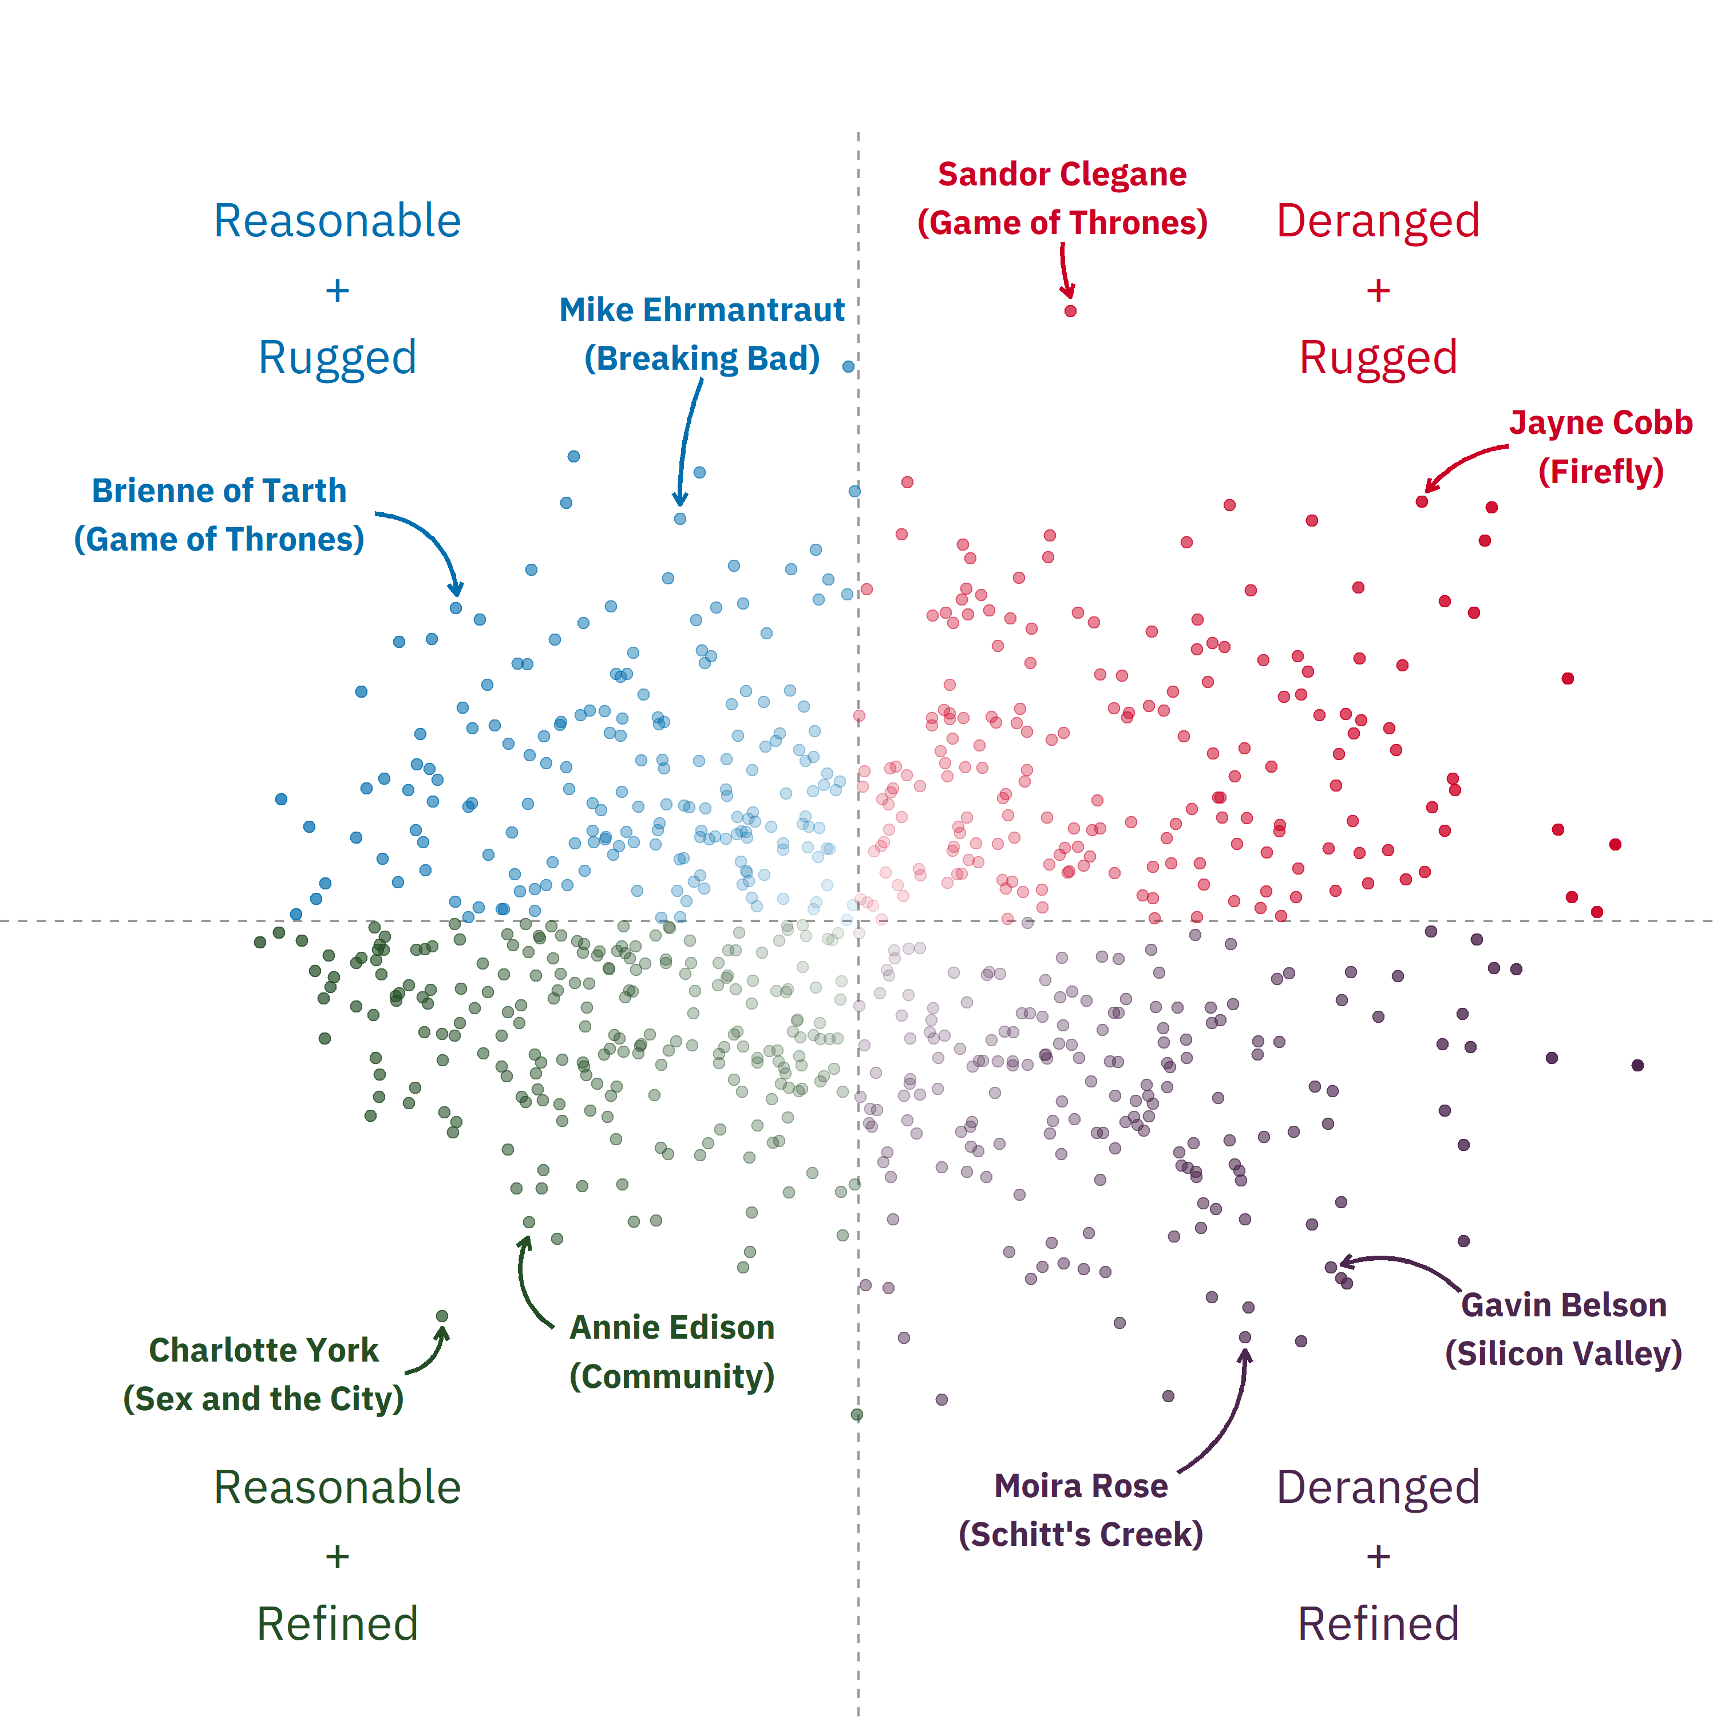

Slide 39
Conduct Principal Component Analysis (PCA) with {tidymodels}
Add text and arrow annotations
Make an interactive chart with {plotly}

Slide 40
I’ll be honest…

Slide 41
I would never put this much effort into analyzing Titanic passengers

Slide 42
Artwork by @allison_horst

Slide 43
great data
Artwork by @allison_horst

Slide 44
The Power of Great Datasets
Alex Cookson
@alexcookson
tacookson
Thank You Allison Horst for the amazing illustration

